Slide 1
Technically feasible and Socially acceptable?

Slide 2
How do properties of materials combine to allow the product to be socially acceptable and technically acceptable?

Slide 3
Socially acceptable?

Slide 4
Suitable for the Queen?

Slide 5
This one?

Slide 6
Or this one?

Slide 7
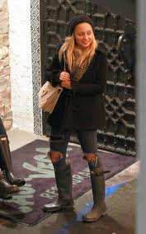
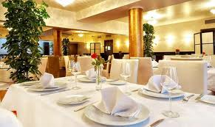
Socially Acceptable?

Slide 8
How do the materials or properties contribute to the produce being socially accepted?
Which one do you think is socially acceptable

Slide 9
Technically Feasible
ABLE TO FUNCTION?

Slide 10
Technically feasible?

Slide 11
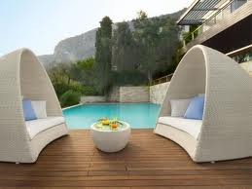
Outdoor Furniture

Slide 12
Cardboard Chair

Slide 13
Technically Feasible?

Slide 14
Cat House

